Slide 1

PANTONE® COLOUR OF THE YEAR 2022

Slide 2
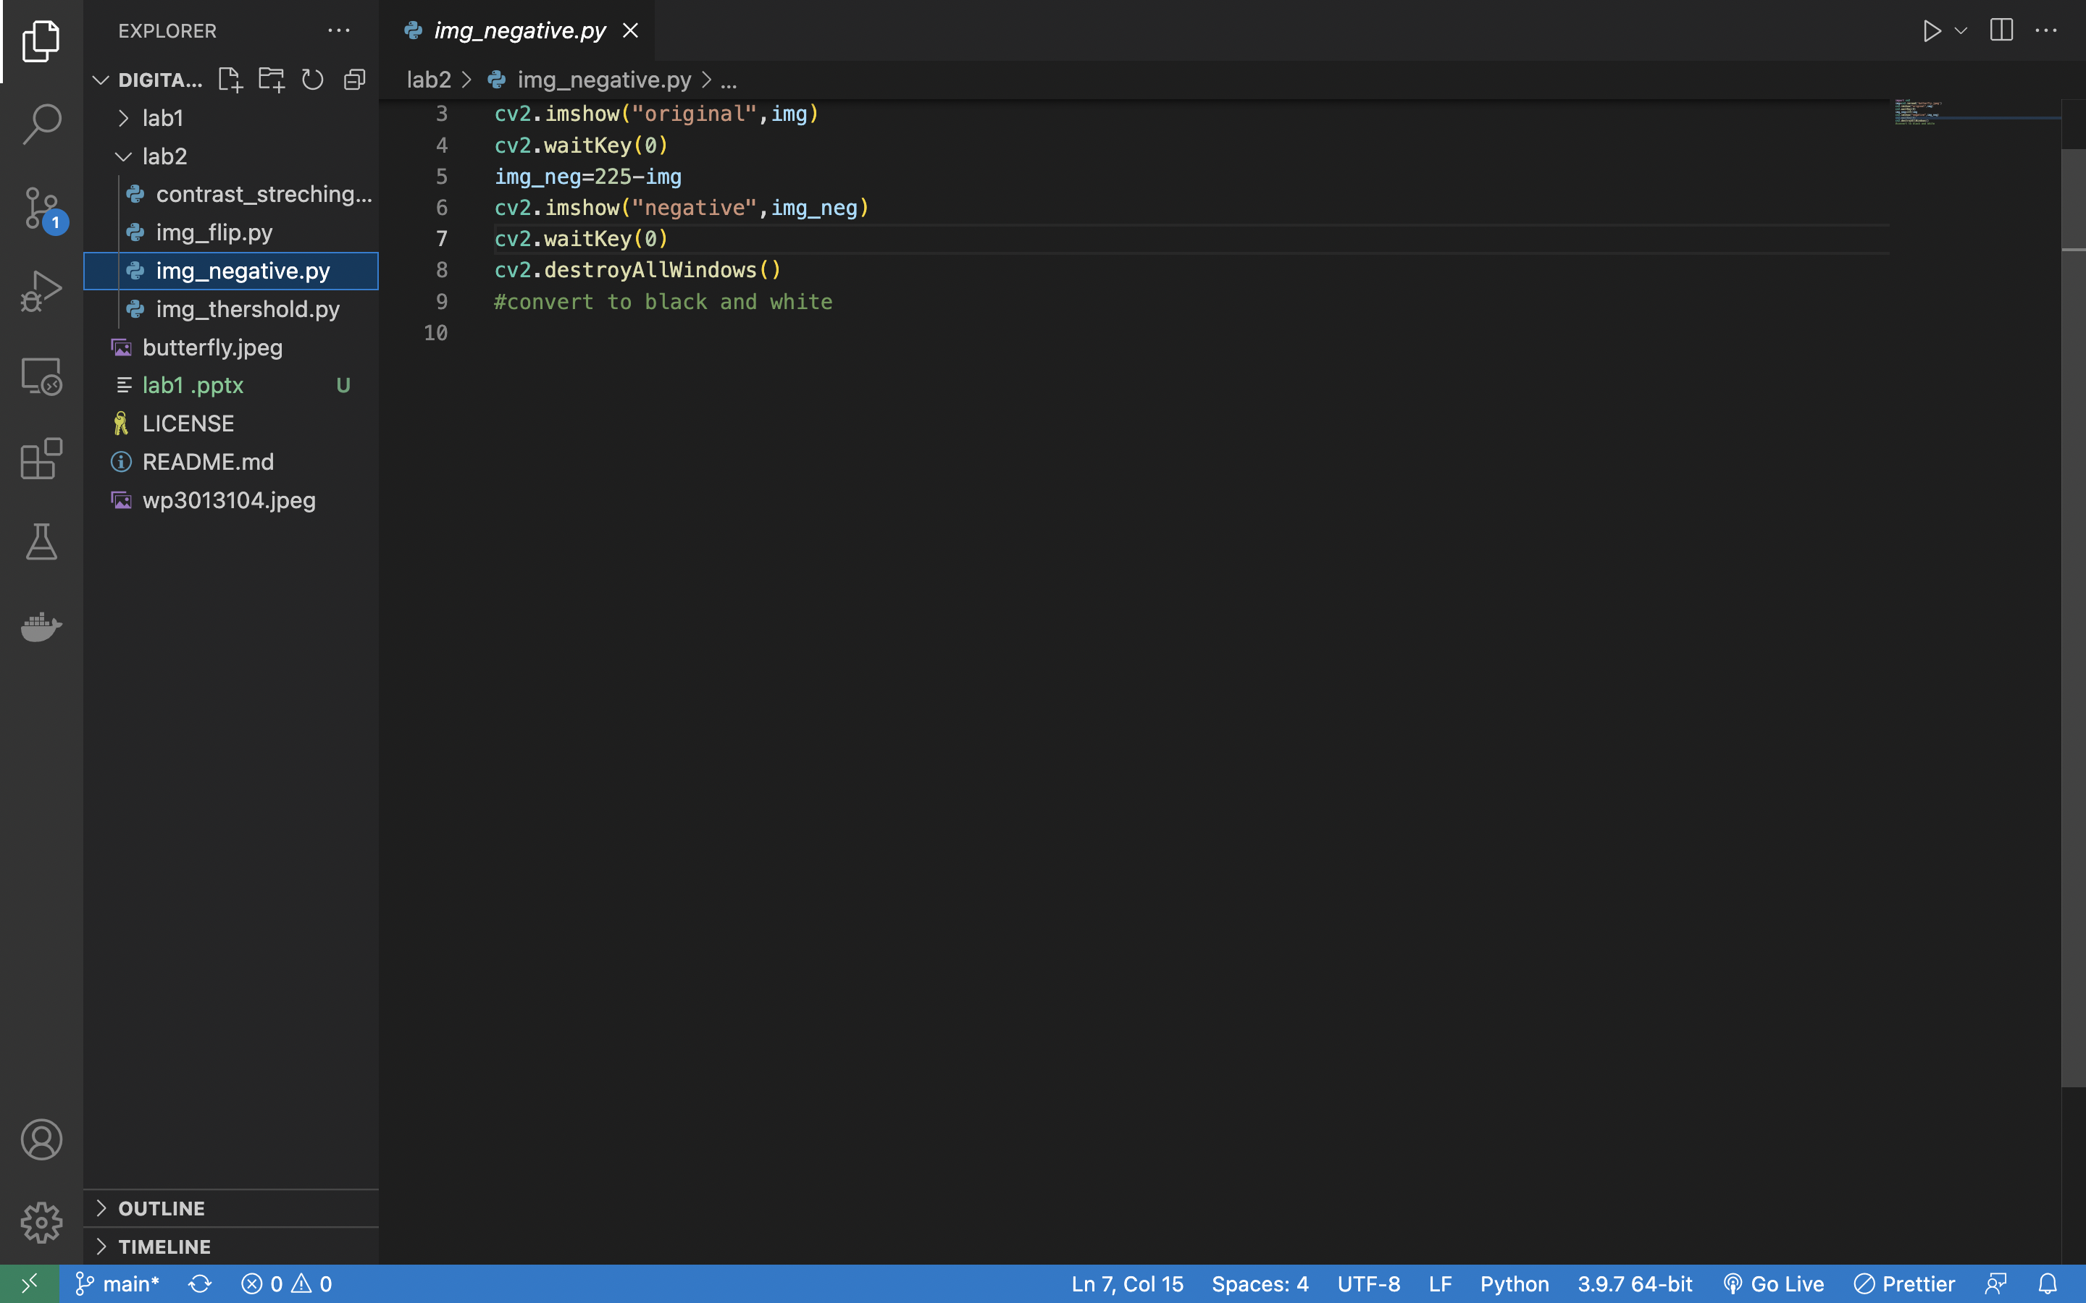
PANTONE® COLOUR OF THE YEAR 2022

Slide 3
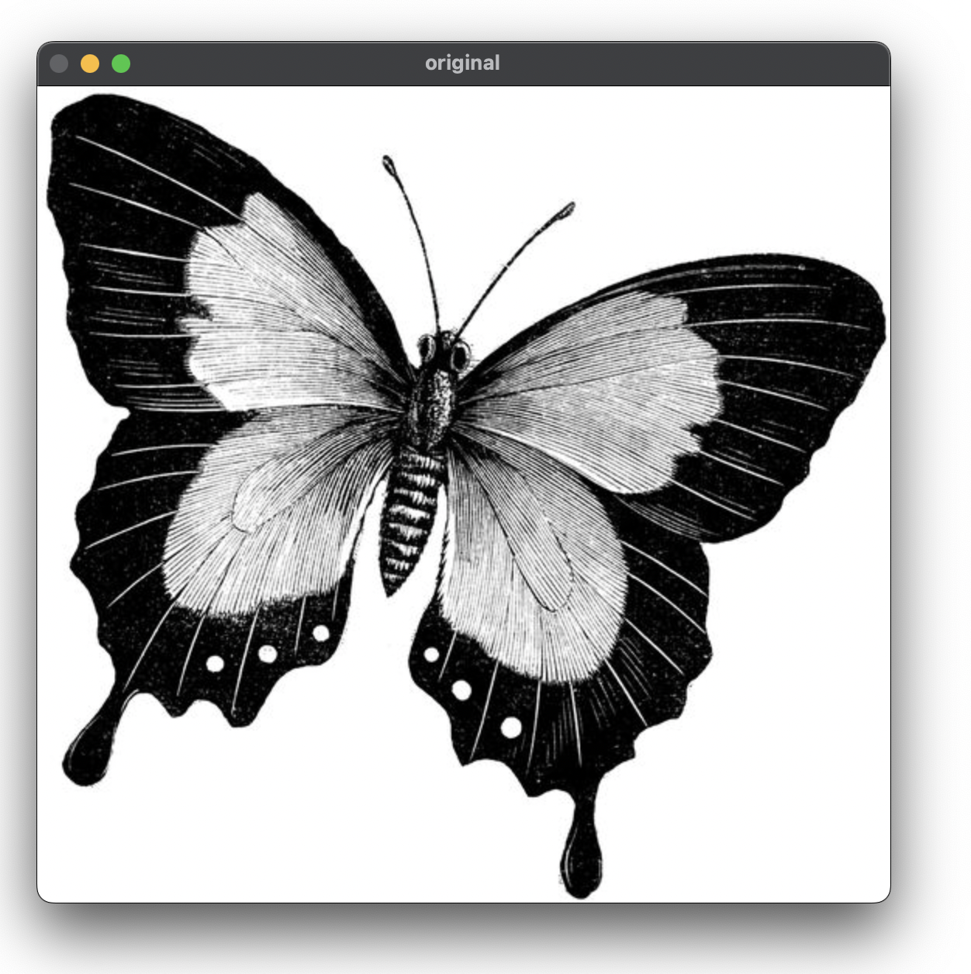
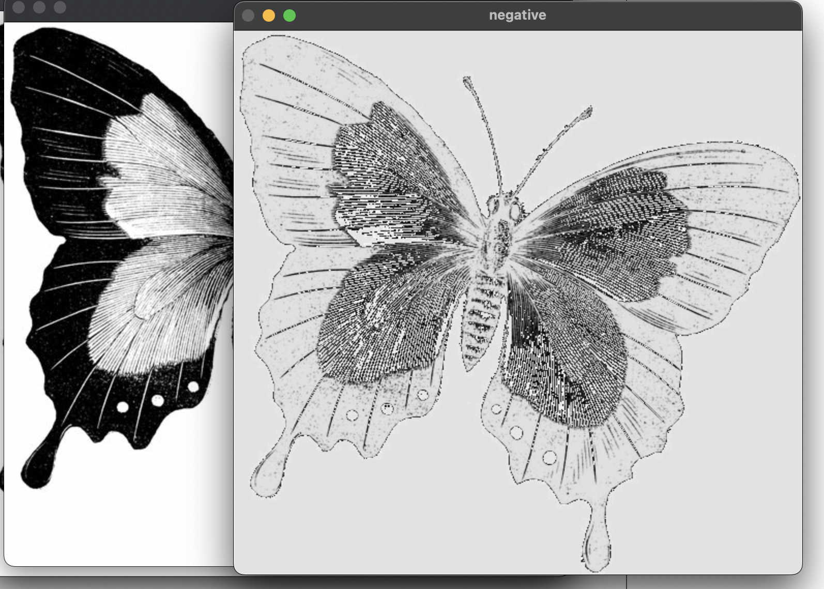
PANTONE® COLOUR OF THE YEAR 2022
OUTPUT-:

Slide 4
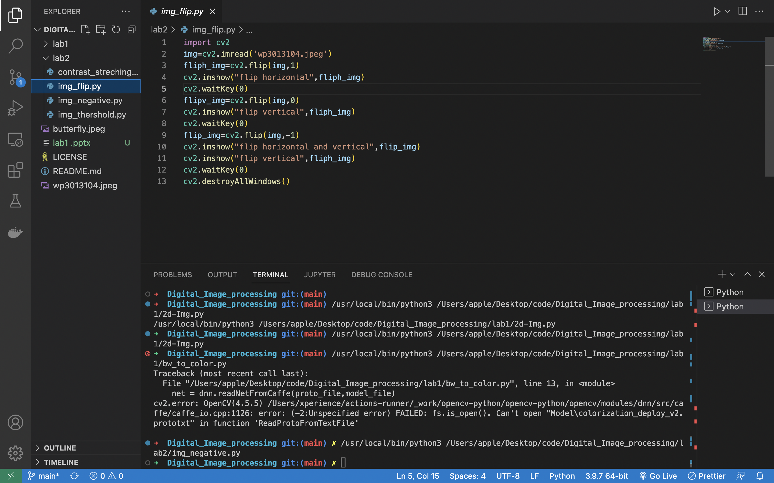
PANTONE® COLOUR OF THE YEAR 2022

Slide 5
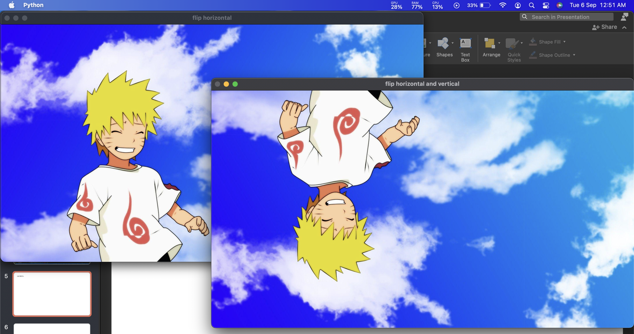
PANTONE® COLOUR OF THE YEAR 2022
OUTPUT-:

Slide 6
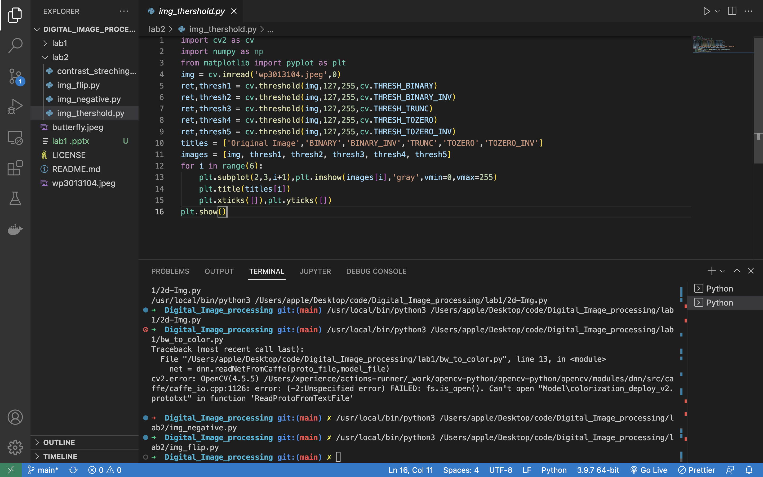
PANTONE® COLOUR OF THE YEAR 2022

Slide 7
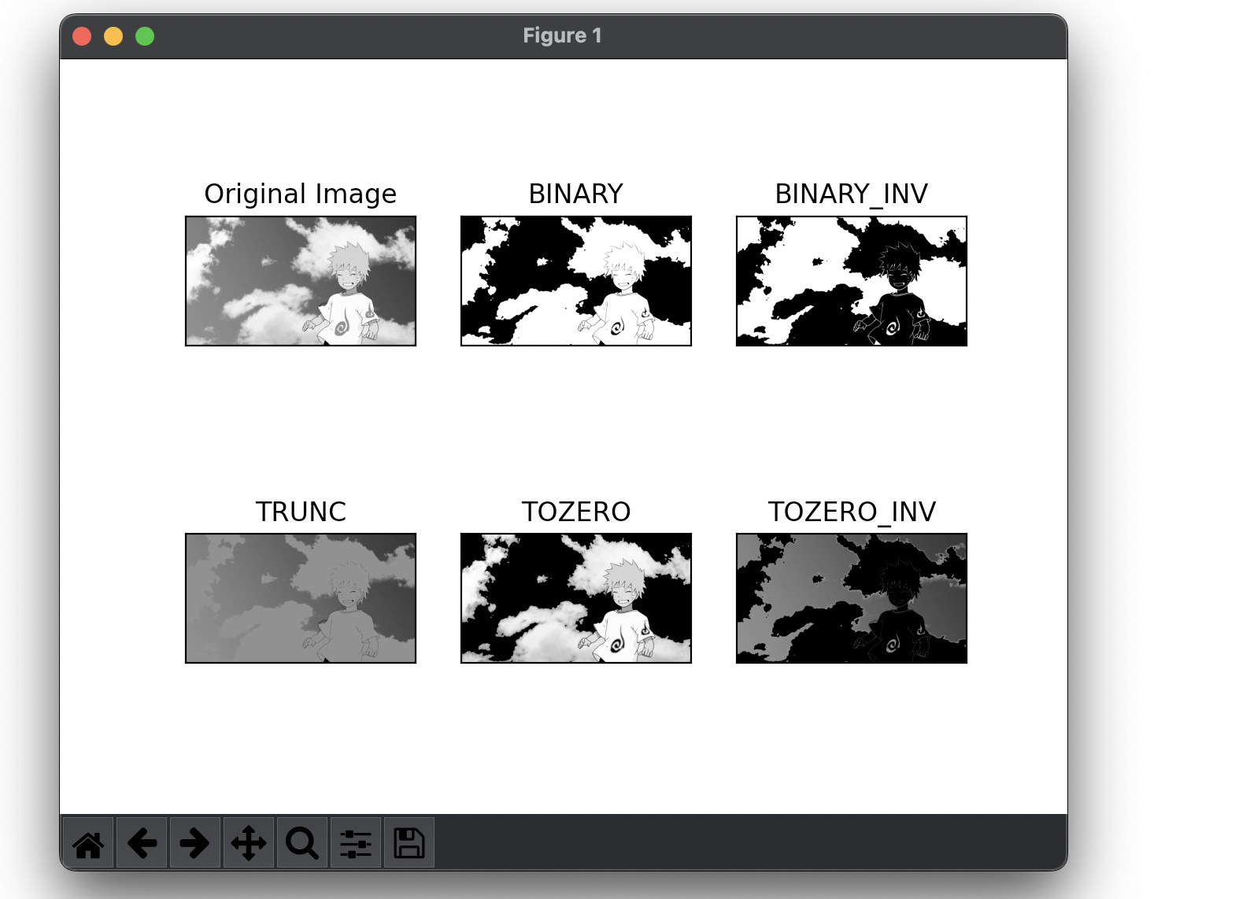
PANTONE® COLOUR OF THE YEAR 2022
OUTPUT-:

Slide 8
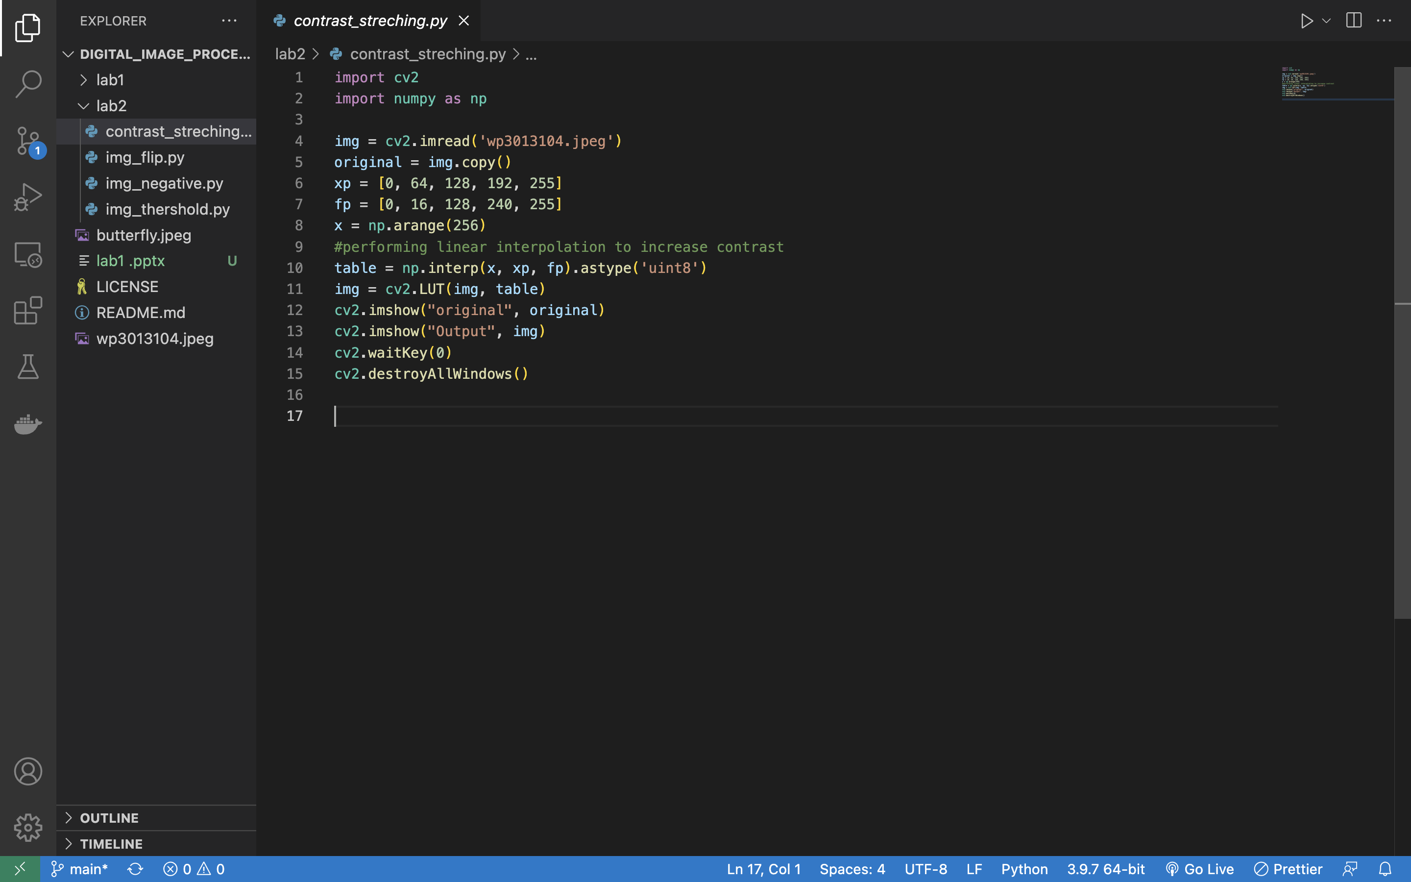
PANTONE® COLOUR OF THE YEAR 2022

Slide 9
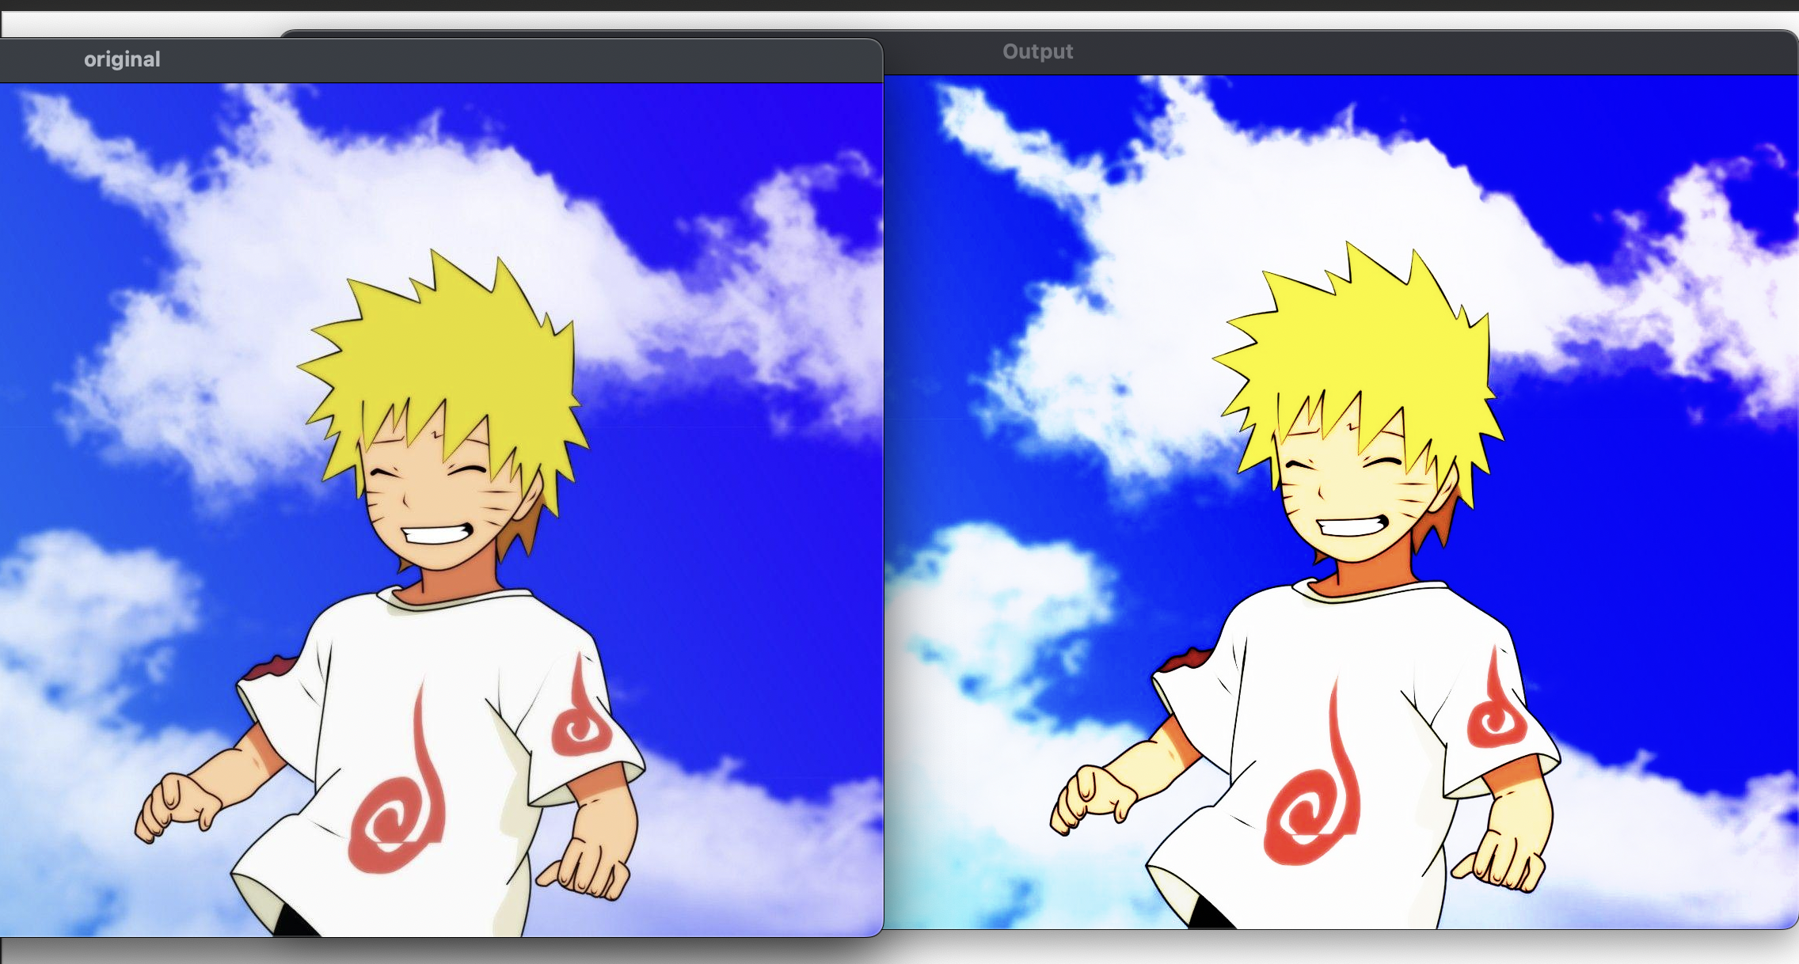
PANTONE® COLOUR OF THE YEAR 2022
OUTPUT-:

Slide 10
THANK YOU You can find the code at -: https://github.com/Baka-14/Digital_Image_processing

